Slide 1




Inside the World's Largest Programming Course
Dr. Charles R. Severance
University of Michigan School of Information
www.py4e.com | online.dr-chuck.com

Slide 2
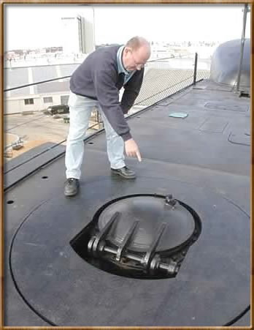

LTI – How it started. (2010)

Slide 3
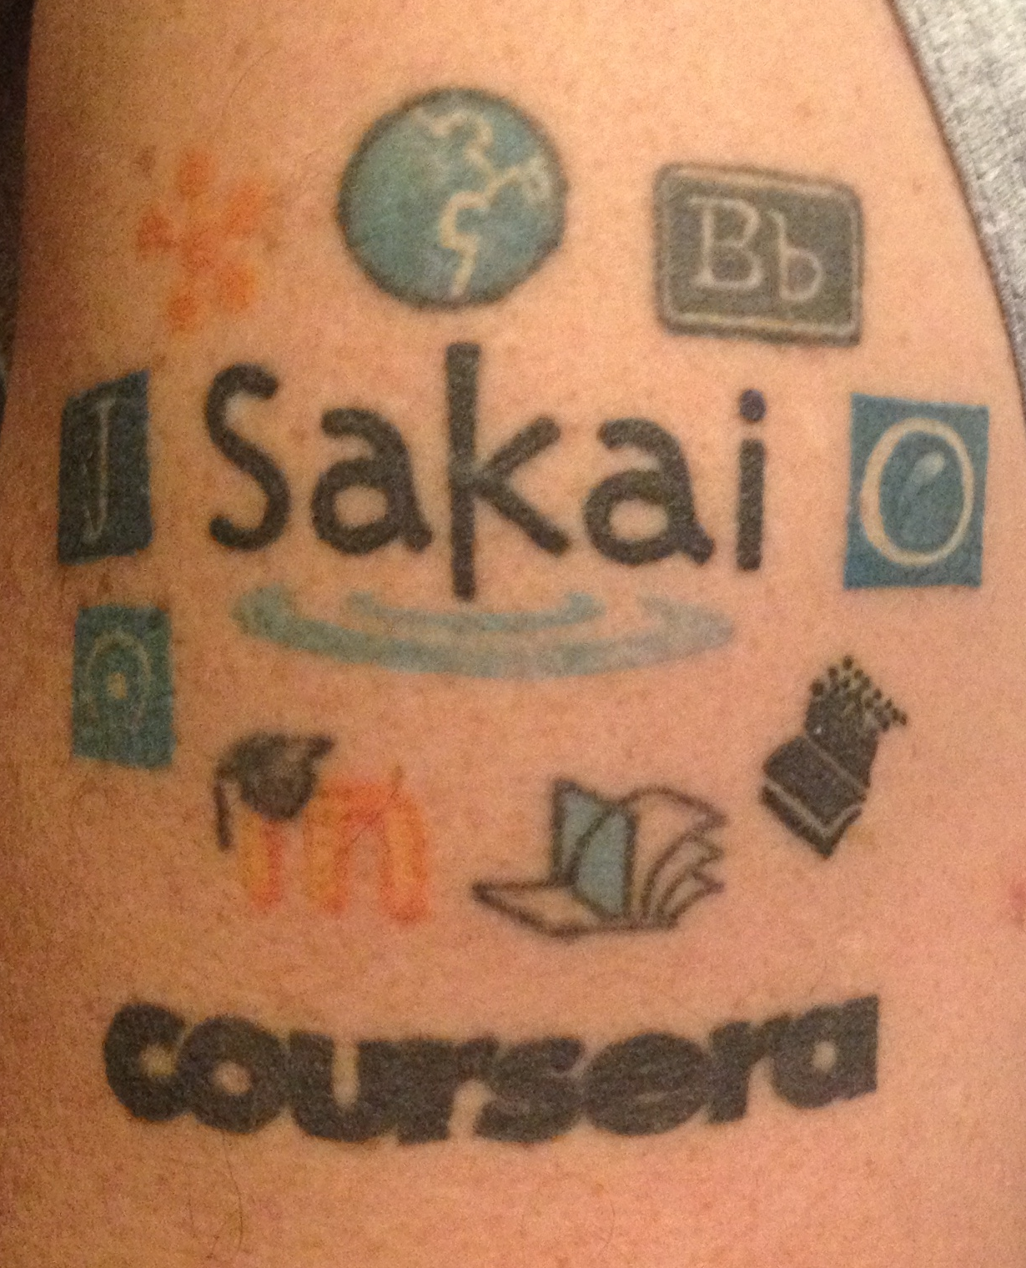
LTI – How it is going. (2014)

Slide 4
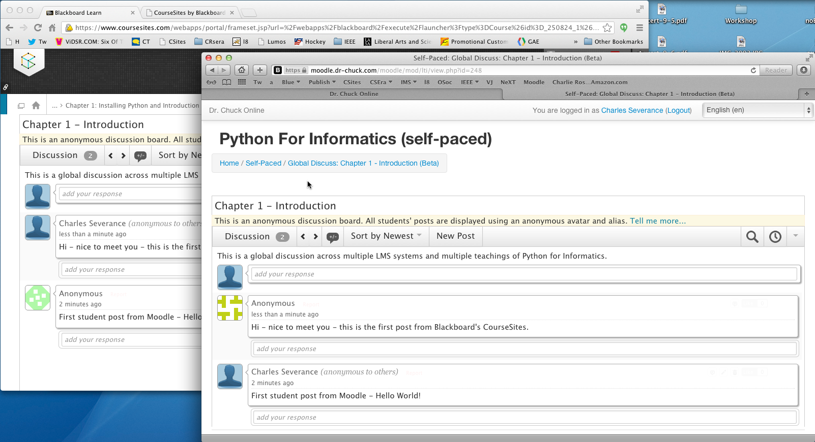
2012 - xpLor

Slide 5

TL;DR
Think like a publisher
Democratize MOOCs
Democratize LORs
Disaggregate LMS

Slide 6
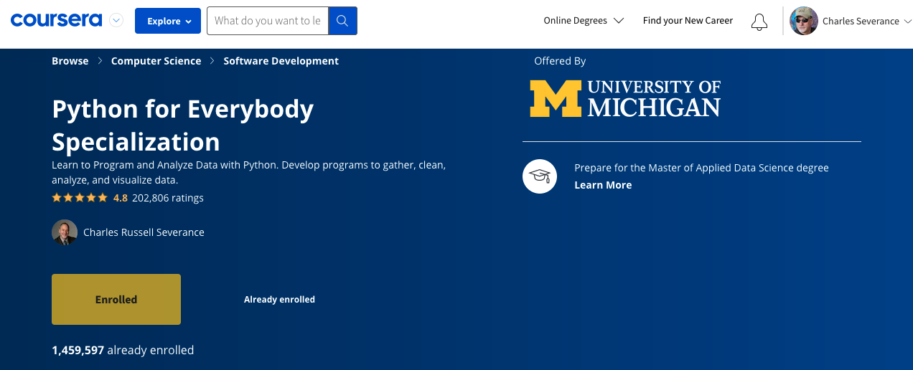
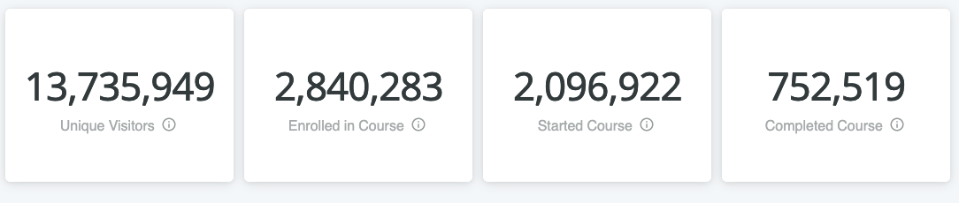

Slide 7
Moar MOOCs
Python for Everybody (5 MOOCs) / www.py4e.com
Django for Everybody (4 MOOCs) / www.dj4e.com
Web Applications for Everybody (4 MOOCs) / www.wa4e.com
PostgreSQL for Everybody (4 MOOCs) / www.pg4e.com
C Programming for Everybody (4 MOOCs) / www.cc4e.com

Slide 8
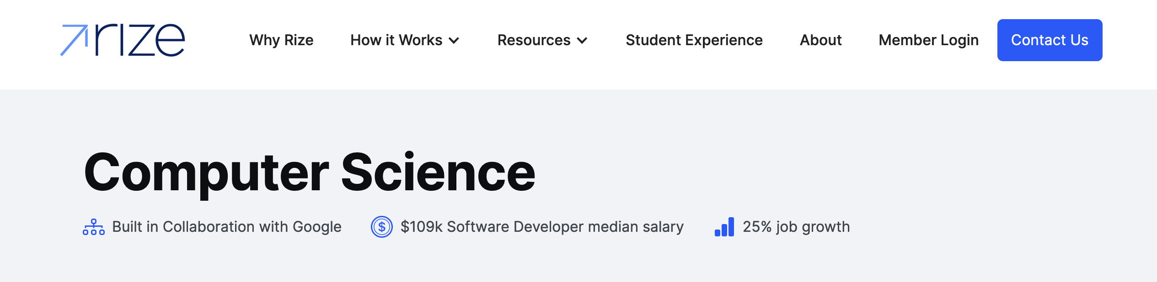
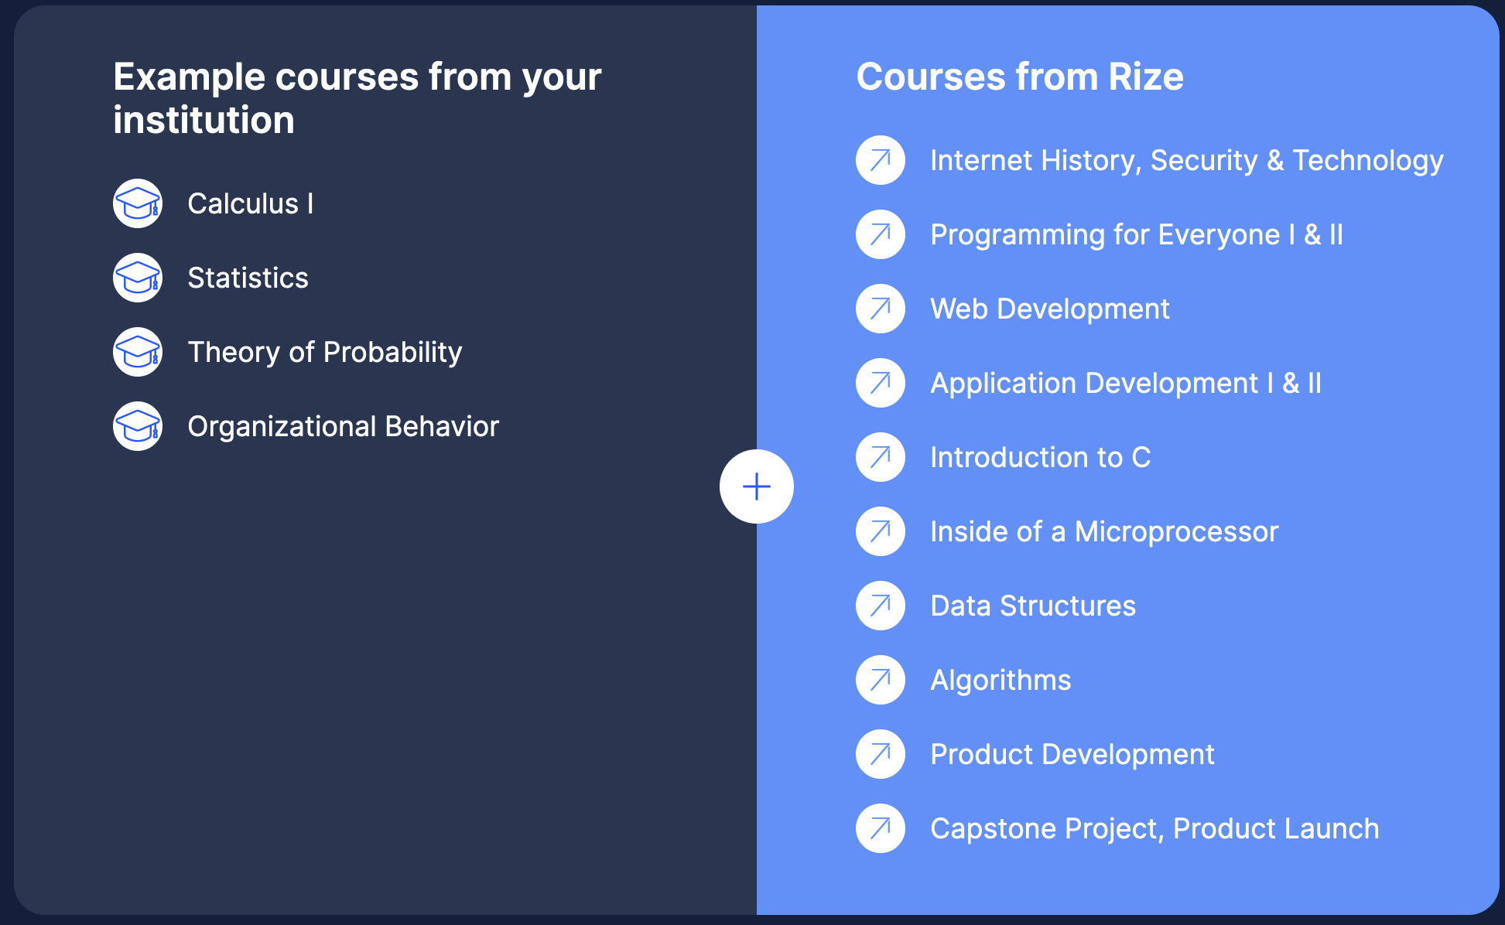
https://www.rize.education/

Slide 9


CreateSpace
200
Pandoc
py4e.com
App Store (次)
Auto graders
OER Content (코스)
150K
github
Media
3M
Coursera
archive.org
Amazon
YouTube
ITunes
Buzzfeed

Slide 10


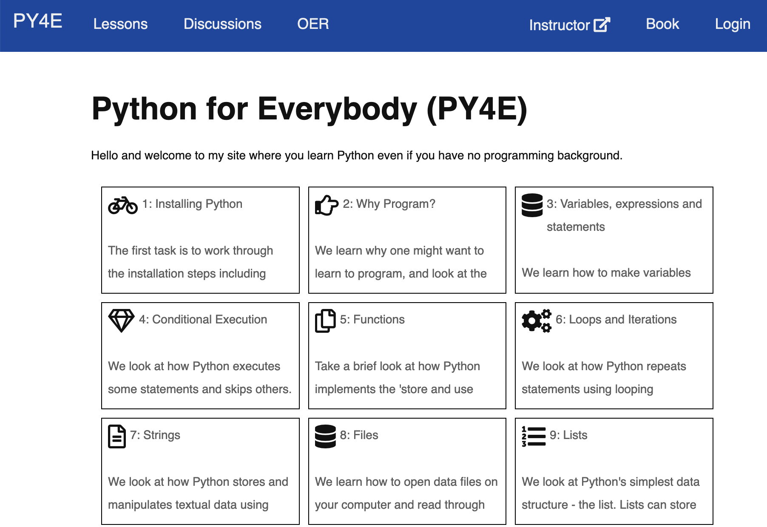


LTI
CC/LTI/DL

Slide 11
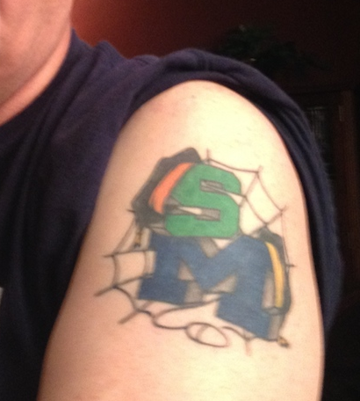
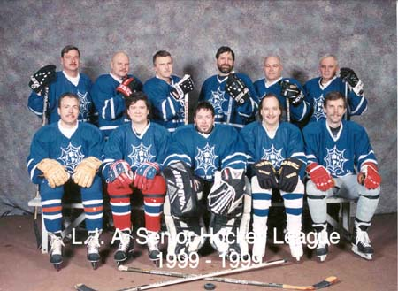

Slide 12
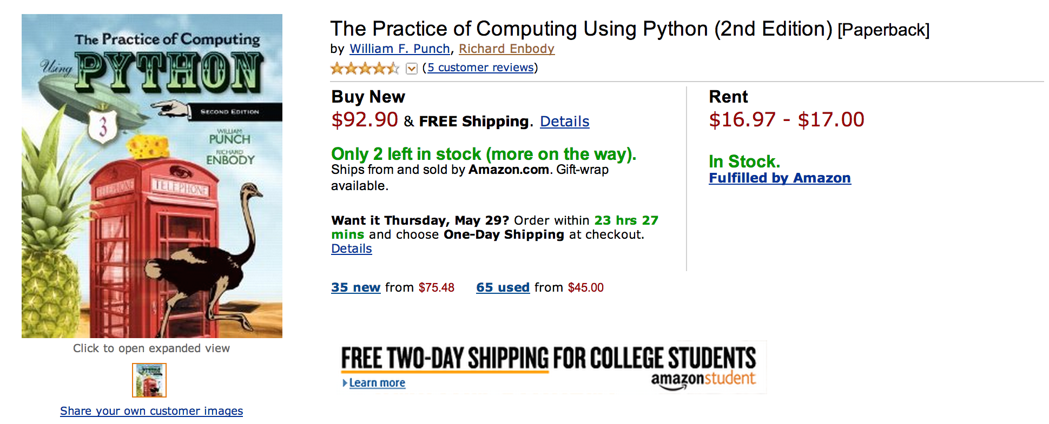
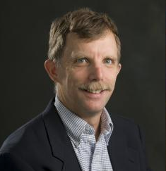
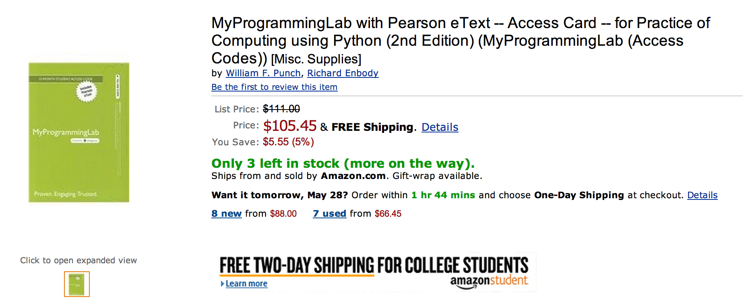

Slide 13
What does $198.35 get you?
Book
Automatic Homework Grading Software
Learning Management System Integration
Instructor Materials
Slides / Solutions Manual / Exams / Course Copy
Instructor Training
Notes:
$65 from Pearson $130 Form bookstore

Slide 14

Teacher Prep
Book
Pearson Value
Proposition
$200
Marketing
Software

Slide 15
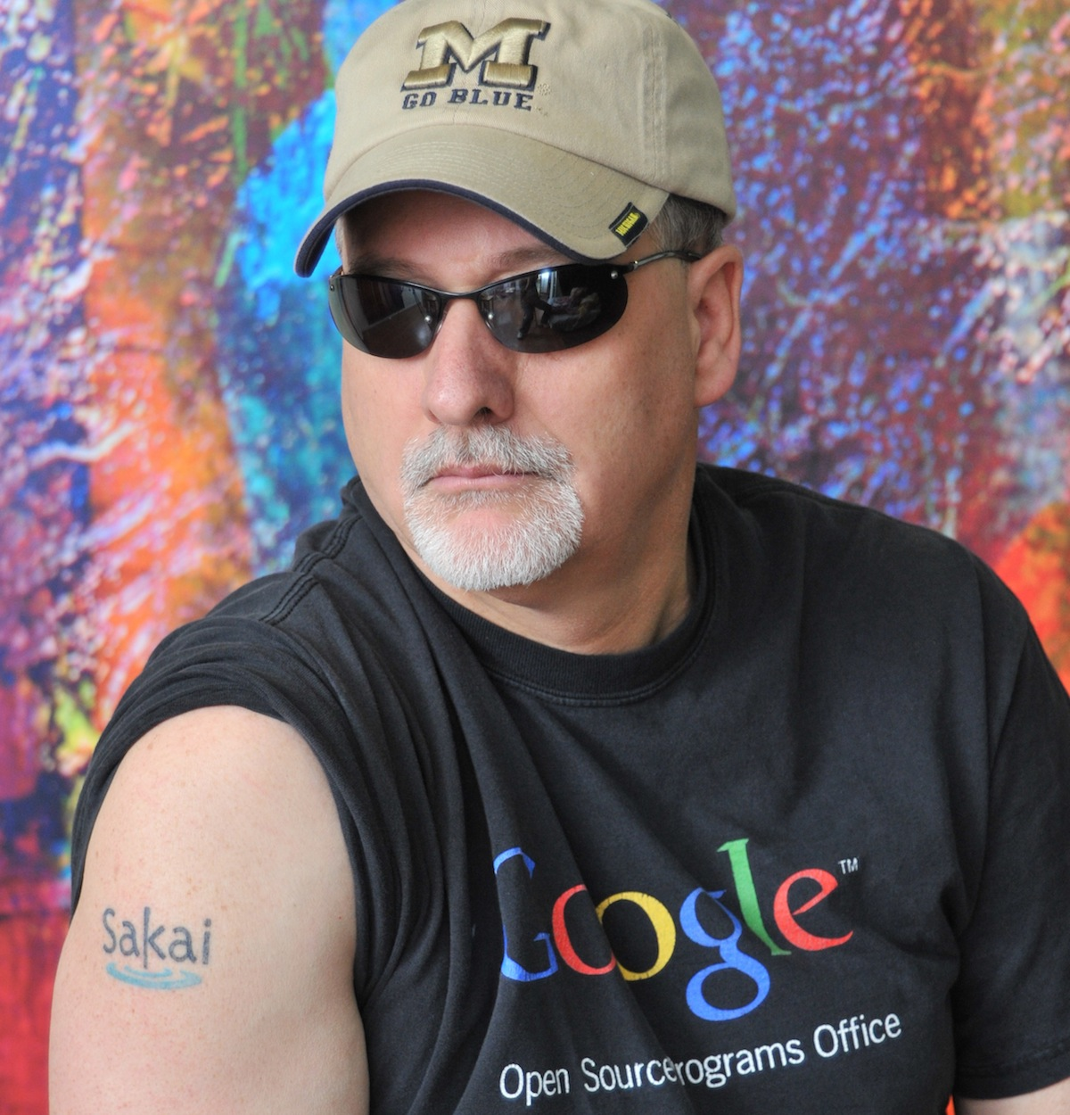
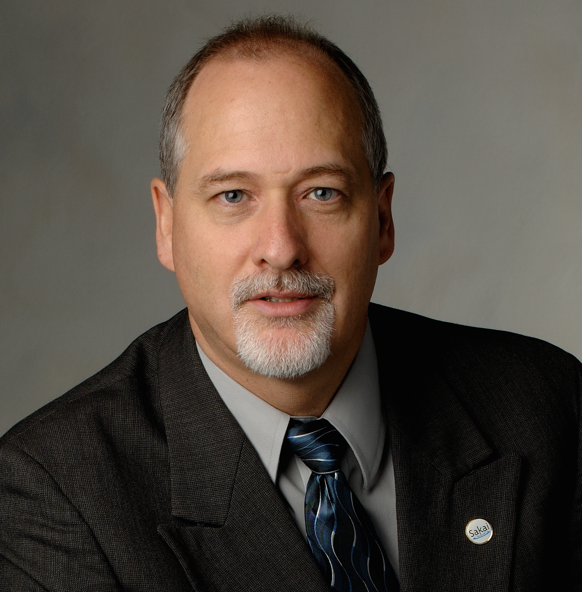



Slide 16

www.masteringphysics.com

Slide 17
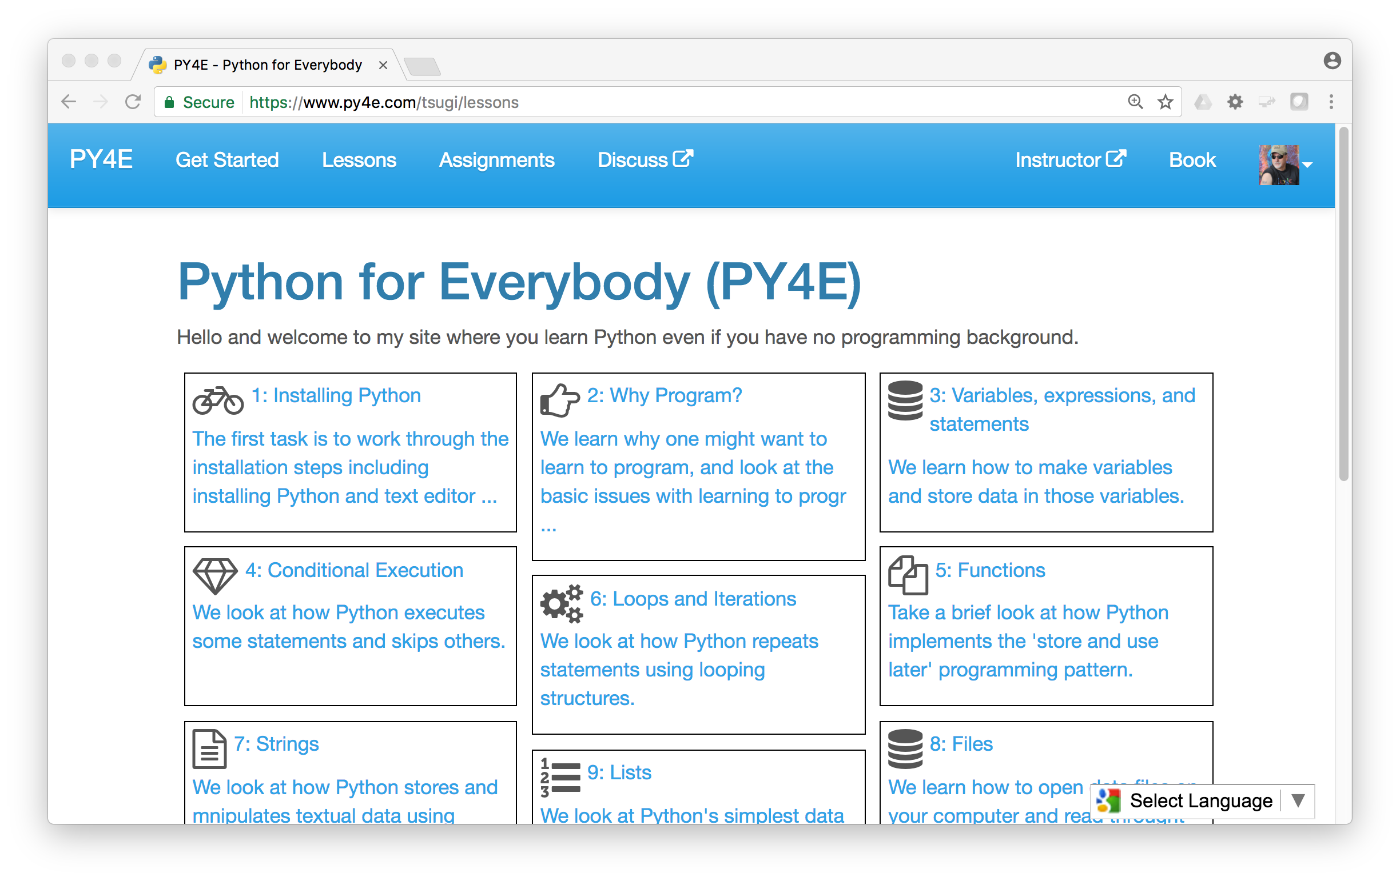
www.py4e.com (a.k.a. www.masteringpython.com)

Slide 18
Deep Linking®
CC®
LTI®
Deep Linking® FILLS THE GAPS AND MAKES CONNECTIONS BETWEEN LEARNING TOOLS INTEROPERABILITY® AND COMMON CARTRIDGE®.
LTI®, CC®, and Content Item® are trademarks of IMS Global Learning Consortium, Inc. (www.imsglobal.org)

Slide 19
Deep Linking®
CC®
LTI®
FOR THE FIRST TIME IN THE HISTORY OF EDUCATIONAL TECHNOLOGY, YOU CAN MAKE AN APP STORE AND LEARNING OBJECT REPOSITORY WITHOUT PROPRIETATY EXTENSIONS.
LTI®, CC®, and Content Item® are trademarks of IMS Global Learning Consortium, Inc. (www.imsglobal.org)

Slide 20
Topics
Educational App Store
API Libraries
"Lego Blocks"
Interoperability
New tools that *teach*
EdTech startups made easy
Training / Documentation
Enrich Open Educational Content
Seamless Content Integration and Reuse (LOR)
Stand-Alone MOOC platform

Slide 21
CreateSpace
10
Pandoc
py4e.com
App Store (次)
OER Content (코스)
3K
github
1.2M
Coursera
Media
UM/Canvas
300
archive.org
Amazon
YouTube
ITunes
GooglePlay

Slide 22
Demo (time permitting)

Slide 23

Any Questions? www.py4e.com online.dr-chuck.com

